Slide 1




DIBBs Brown Dog An Extensible and Distributed Data Transformation Service for Science

Slide 2

Photos
Structural Defects
Image Stitching
Materials Development
Gap Filling
Green Infrastructure
Tabular Data
Loss of Organ Function
Root Tip Tracking
Mapping
Evolution
NLP
Databases
Underwater Photos
Climate Modeling
Video
Hyperspectral
Lidar
Microscopy Images
Historic Maps
Color Correction
Publications
Radar
Flood Plain Analysis
Documents
River Depth Distribution
Hazard Modeling
Cell Tracking
Web Sites
People Detection/Tracking
Bee Colony Behavior
Feedlot Tracking
Stream Detection and Sinuosity
River Maturity
Paleoclimate
Bee Detection/Tracking
Phenomics
Human Preference Modeling
Tissue Classification
Pollen Detection/Classification
Satellite/Aerial Photos
Land Cover/Usage
Regions in Conflict
Species Detection/Counting
Disease Detection
Coastline Changes
Reef Changes
Water Detection (e.g. Lakes, Retaining Ponds)
Sentiment Analysis
Large Dynamic Group Behavior
River Meander
Food Supply
Pre-Digital Datasets
3D Data
Handwritten Documents
Renal Failure
3D Reconstruction
Event Detection
Simulations

Slide 3
Ecosystems and Climate Change
M. Dietze, K. McHenry, A. Desai, “Model-data Synthesis and Forecasting Across the Upper Midwest: Partitioning Uncertainty and Environmental Heterogeneity in Ecosystem Carbon,” NSF DBI-1062547, 2011-2014
M. Dietze, K. McHenry, A. Desai, “ABI Development: The PEcAn Project - A Community Platform for Ecological Forecasting,” NSF DBI-1457890, 2015-2019
Towards regional-scale high resolution estimates of plant life and carbon storage
Scientific workflow and data assimilation system connecting a variety of models within the Ecology community to a variety of data sources
Grown to 52 developers over the past 3 years
NCSA / U. Illinois, BU, Brookhaven National Lab, University of Wisconsin, University of Notre Dame, Utah State, Columbia University, Pacific Northwest National Laboratory, DuPont Pioneer, Exeter College, UK, U. Arizona, Dartmouth College
Notes:
Other potential models: STVGM, Jeweles, CLM

Slide 4
Ecosystems and Climate Change
Models:
Ecosystem Demography (ED)
SIPNET
DALEC
…
Data:
Biofuel Ecophysiological Trait and Yield Database (BETY)
Forest Inventory and Analysis (FIA)
North American Regional Reanalysis (NARR)
North American Carbon Program (NACP)
Food and Agriculture Organization (FAO)
…
Notes:
Other potential models: STVGM, Jeweles, CLM

Slide 5
Ecosystems and Climate Change
Data with Unstructured Aspects:
MODIS (Multi-spectral)
Lidar
Palsar (Radar)
Aviris (Airborne Infrared Spectrometer)
Landsat (Images)
Published results (e.g. tables, figures, plots)
Manually done to ingest into BETY
Notes:
Multispectral, lidar, radar, airborne infrared spectrometer, images

Slide 6
Ecosystems and Climate Change
Settlement Vegetation data
Born Physical
Paper, Microfiche, Alphanumeric/Color coded on vellum sheets
Born Digital
PDF, JPEG, GIF, TIFF, XLS, XLSX, CSV, SHP, netCDF, HDF5, XML, GRIB, GRIB2, geoTIFF, DBF, BIL, BIP, ARC, SDTS, SRTM, IMG, UA, LGW, SXW, ODS
Ad hoc formats:
Spreadsheets
Databases
Services
R Data
Matlab Data
Document

Slide 7
Ecosystems and Climate Change
Settlement Vegetation data
Born Physical
Paper, Microfiche, Alphanumeric/Color coded on vellum sheets
Born Digital
PDF, JPEG, GIF, TIFF, XLS, XLSX, CSV, SHP, netCDF, HDF5, XML, GRIB, GRIB2, geoTIFF, DBF, BIL, BIP, ARC, SDTS, SRTM, IMG, UA, LGW, SXW, ODS
Ad hoc formats:
Spreadsheets
Databases
Services
R Data
Matlab Data
Document
Image

Slide 8
Ecosystems and Climate Change
Settlement Vegetation data
Born Physical
Paper, Microfiche, Alphanumeric/Color coded on vellum sheets
Born Digital
PDF, JPEG, GIF, TIFF, XLS, XLSX, CSV, SHP, netCDF, HDF5, XML, GRIB, GRIB2, geoTIFF, DBF, BIL, BIP, ARC, SDTS, SRTM, IMG, UA, LGW, SXW, ODS
Ad hoc formats:
Spreadsheets
Databases
Services
R Data
Matlab Data
Document
Image
Spatial

Slide 9
Ecosystems and Climate Change
Settlement Vegetation data
Born Physical
Paper, Microfiche, Alphanumeric/Color coded on vellum sheets
Born Digital
PDF, JPEG, GIF, TIFF, XLS, XLSX, CSV, SHP, netCDF, HDF5, XML, GRIB, GRIB2, geoTIFF, DBF, BIL, BIP, ARC, SDTS, SRTM, IMG, UA, LGW, SXW, ODS
Ad hoc formats:
Spreadsheets
Databases
Services
R Data
Matlab Data
Document
Image
Spatial
Tabular

Slide 10
Ecosystems and Climate Change
Settlement Vegetation data
Born Physical
Paper, Microfiche, Alphanumeric/Color coded on vellum sheets
Born Digital
PDF, JPEG, GIF, TIFF, XLS, XLSX, CSV, SHP, netCDF, HDF5, XML, GRIB, GRIB2, geoTIFF, DBF, BIL, BIP, ARC, SDTS, SRTM, IMG, UA, LGW, SXW, ODS
Ad hoc formats:
Spreadsheets
Databases
Services
R Data
Matlab Data
Document
Image
Spatial
Tabular
Weather

Slide 11
Ecosystems and Climate Change
Settlement Vegetation data
Born Physical
Paper, Microfiche, Alphanumeric/Color coded on vellum sheets
Born Digital
PDF, JPEG, GIF, TIFF, XLS, XLSX, CSV, SHP, netCDF, HDF5, XML, GRIB, GRIB2, geoTIFF, DBF, BIL, BIP, ARC, SDTS, SRTM, IMG, UA, LGW, SXW, ODS
Ad hoc formats:
Spreadsheets
Databases
Services
R Data
Matlab Data
Document
Image
Spatial
Tabular
Weather
3D

Slide 12
Ecosystems and Climate Change
Settlement Vegetation data
Born Physical
Paper, Microfiche, Alphanumeric/Color coded on vellum sheets
Born Digital
PDF, JPEG, GIF, TIFF, XLS, XLSX, CSV, SHP, netCDF, HDF5, XML, GRIB, GRIB2, geoTIFF, DBF, BIL, BIP, ARC, SDTS, SRTM, IMG, UA, LGW, SXW, ODS
Ad hoc formats:
Spreadsheets
Databases
Services
R Data
Matlab Data
Document
Image
Spatial
Tabular
Weather
3D
Archive, Database, Filesystem, …

Slide 13
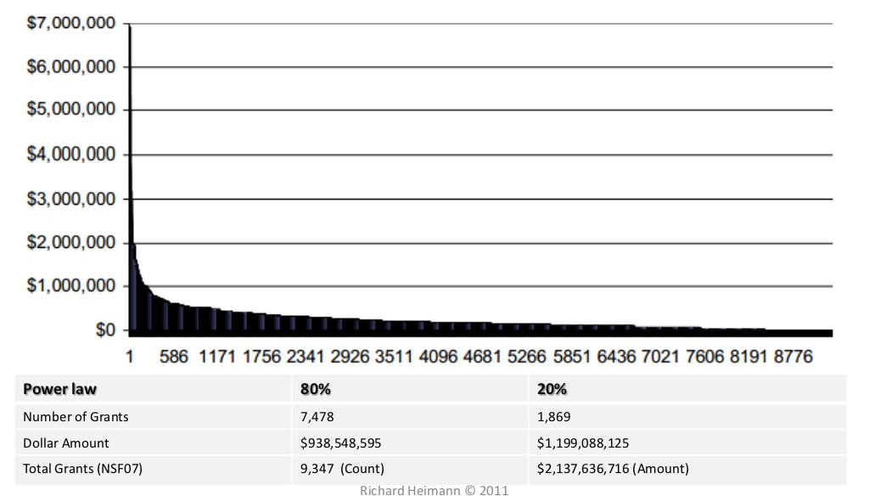
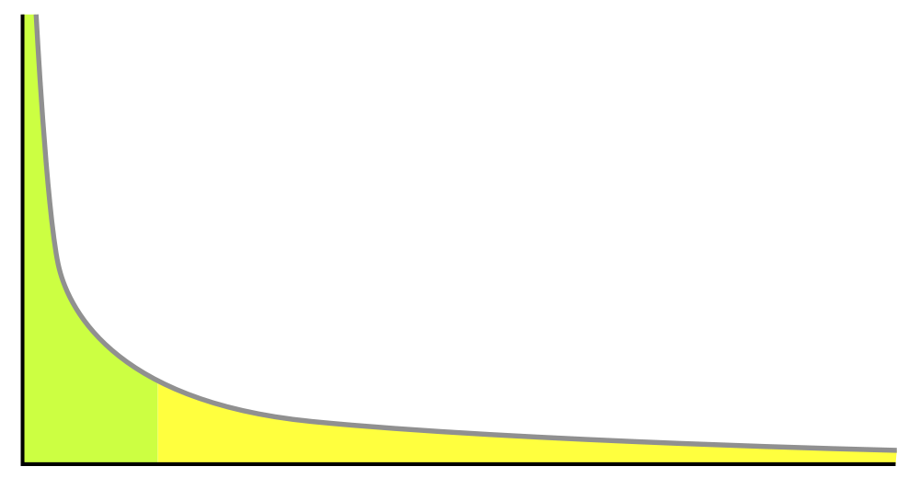
“Big Data”
Large quantities of data
Large varieties of data
“Long-Tail”
Dollars
Number of grants
http://www.slideshare.net/rheimann04/big-social-data-the-social-turn-in-big-data
http://www.slideshare.net/rheimann04/big-social-data-the-social-turn-in-big-data

Slide 14
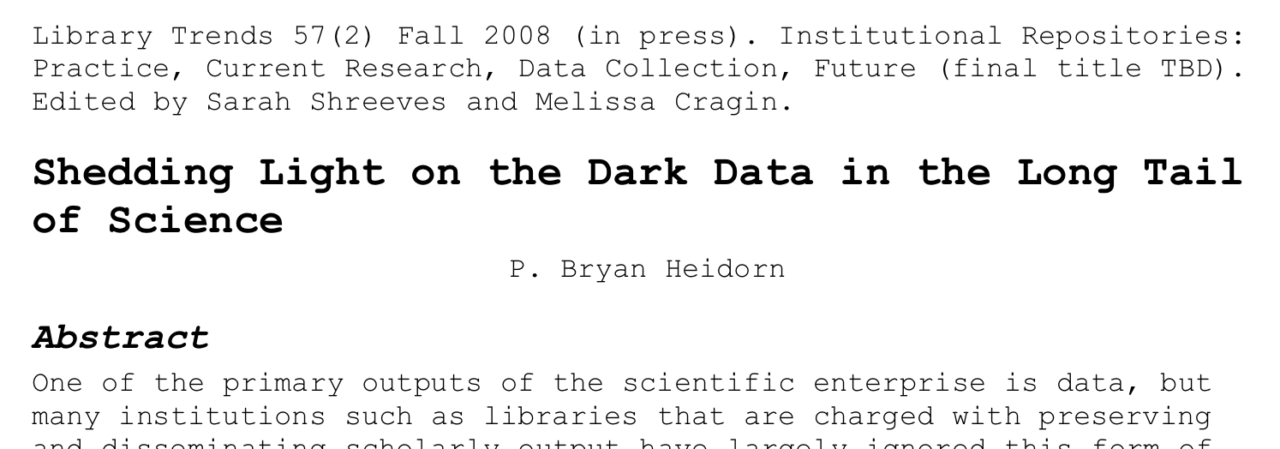
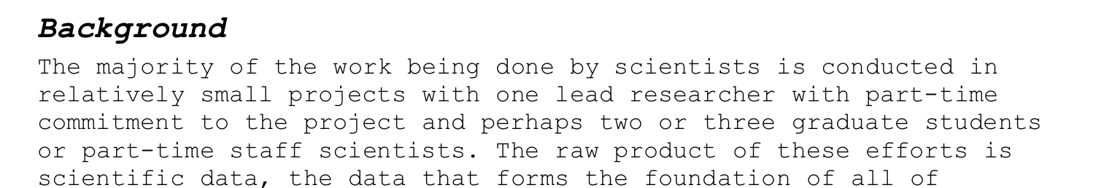
The “Long-Tail” of “Big Data”
…

Slide 15


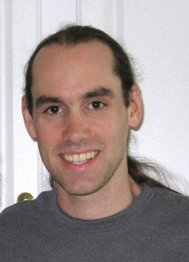
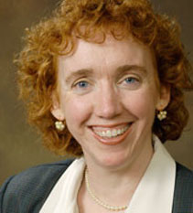
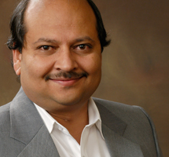
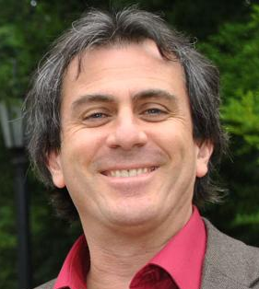
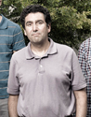
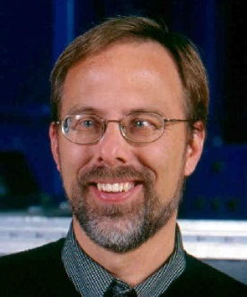

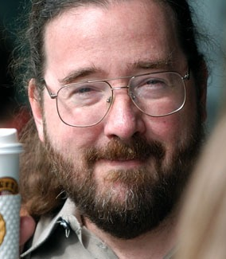
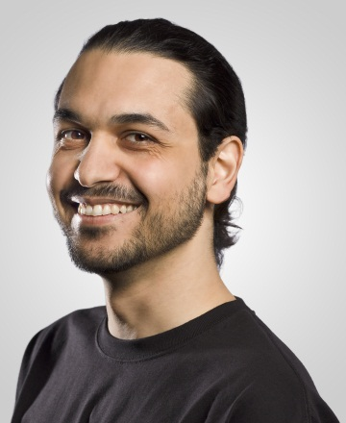
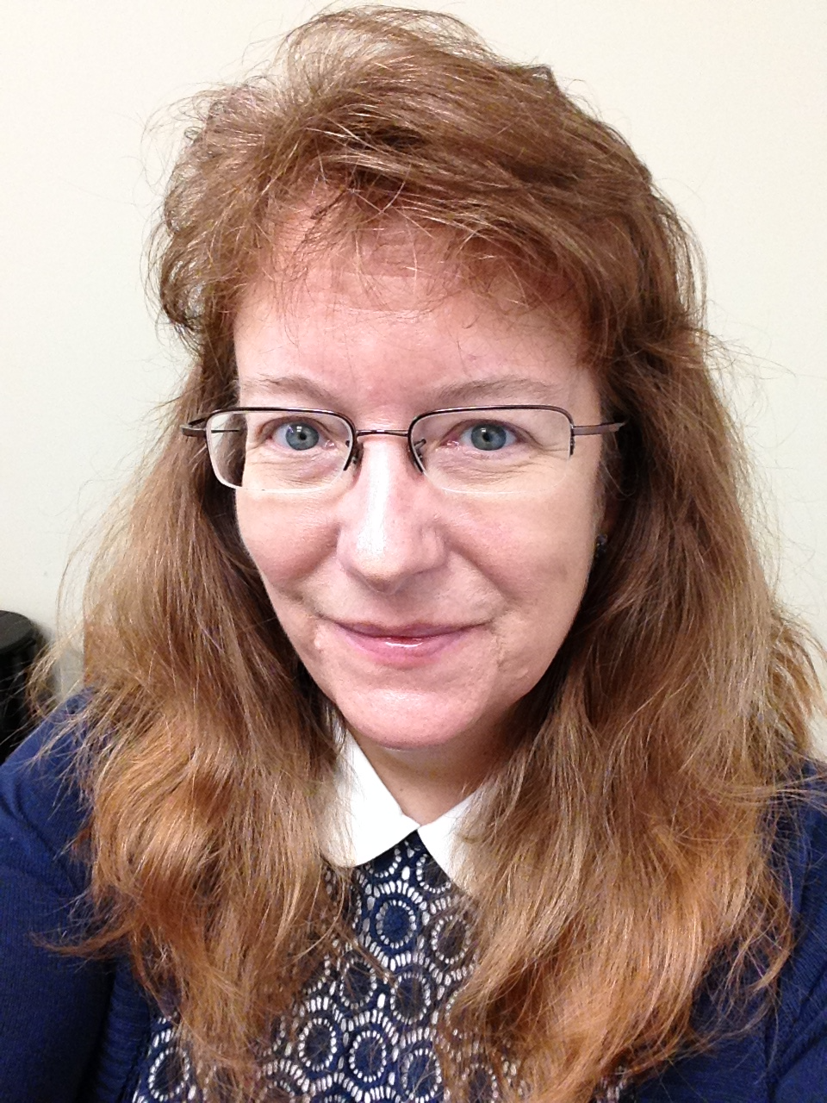

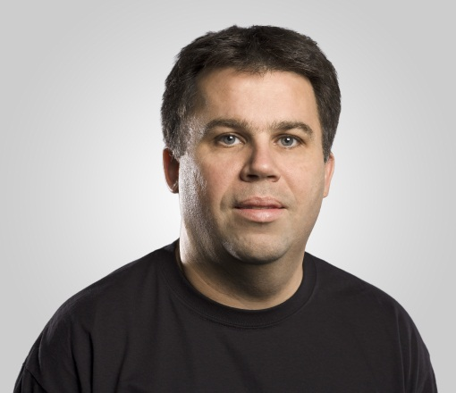
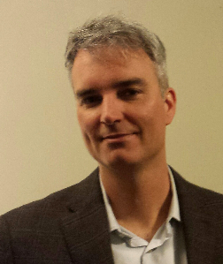
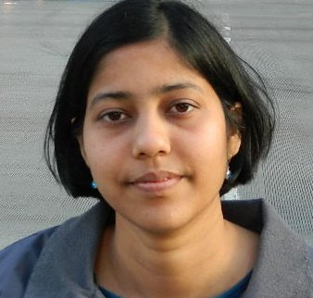

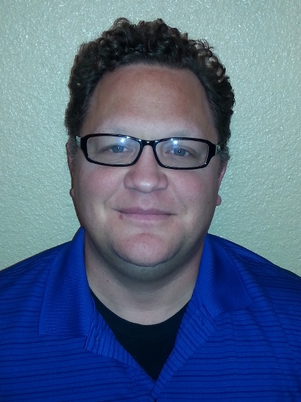

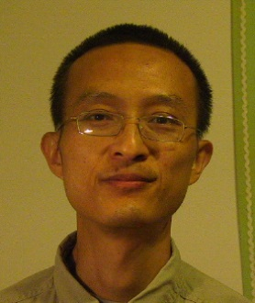

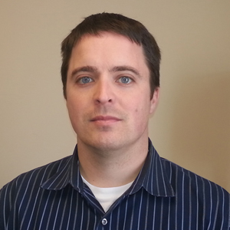

Slide 16
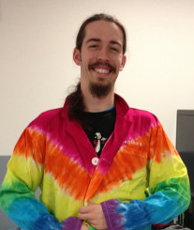
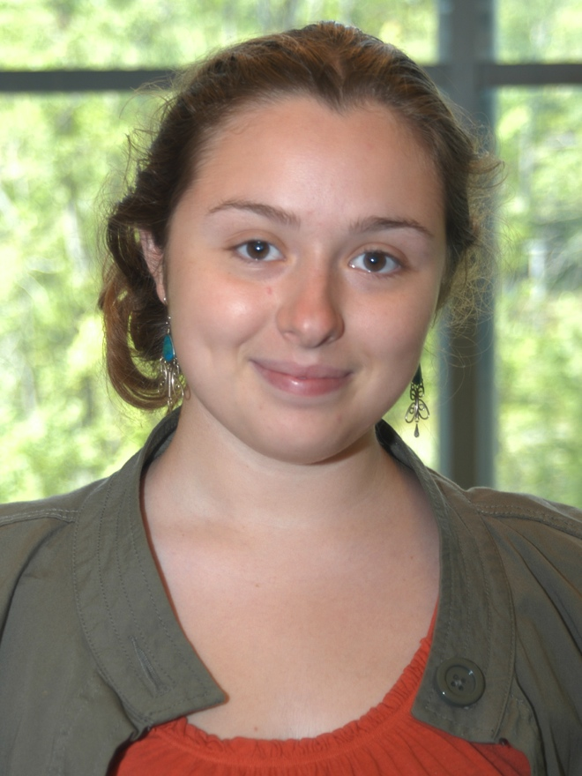
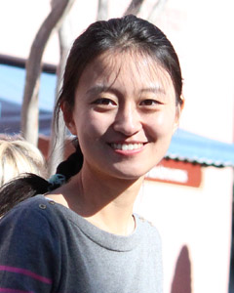
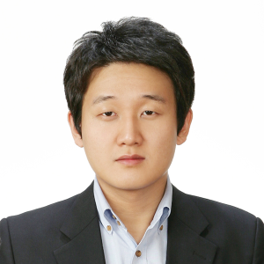
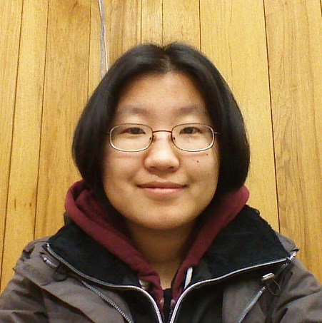

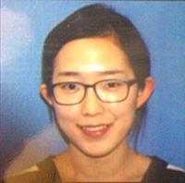
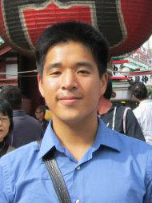

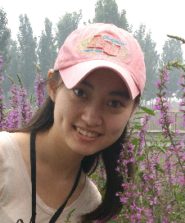
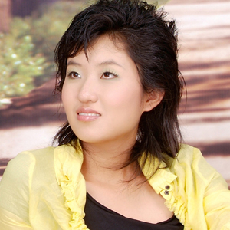

Slide 17
Photos
Structural Defects
Image Stitching
Materials Development
Gap Filling
Green Infrastructure
Tabular Data
Loss of Organ Function
Root Tip Tracking
Mapping
Evolution
NLP
Databases
Underwater Photos
Climate Modeling
Video
Hyperspectral
Lidar
Microscopy Images
Historic Maps
Color Correction
Publications
Radar
Flood Plain Analysis
Documents
River Depth Distribution
Hazard Modeling
Cell Tracking
Web Sites
People Detection/Tracking
Bee Colony Behavior
Feedlot Tracking
Stream Detection and Sinuosity
River Maturity
Paleoclimate
Bee Detection/Tracking
Phenomics
Human Preference Modeling
Tissue Classification
Pollen Detection/Classification
Satellite/Aerial Photos
Land Cover/Usage
Regions in Conflict
Species Detection/Counting
Disease Detection
Coastline Changes
Reef Changes
Water Detection (e.g. Lakes, Retaining Ponds)
Sentiment Analysis
Large Dynamic Group Behavior
River Meander
Food Supply
Pre-Digital Datasets
3D Data
Handwritten Documents
Renal Failure
3D Reconstruction
Event Detection
Simulations

Slide 18
Photos
Structural Defects
Image Stitching
Materials Development
Gap Filling
Green Infrastructure
Tabular Data
Loss of Organ Function
Root Tip Tracking
Mapping
Evolution
NLP
Databases
Underwater Photos
Climate Modeling
Video
Hyperspectral
Lidar
Microscopy Images
Historic Maps
Color Correction
Publications
Radar
Flood Plain Analysis
Documents
River Depth Distribution
Hazard Modeling
Cell Tracking
Web Sites
People Detection/Tracking
Bee Colony Behavior
Feedlot Tracking
Stream Detection and Sinuosity
River Maturity
Paleoclimate
Bee Detection/Tracking
Phenomics
Human Preference Modeling
Tissue Classification
Pollen Detection/Classification
Satellite/Aerial Photos
Land Cover/Usage
Regions in Conflict
Species Detection/Counting
Disease Detection
Coastline Changes
Reef Changes
Water Detection (e.g. Lakes, Retaining Ponds)
Sentiment Analysis
Large Dynamic Group Behavior
River Meander
Food Supply
Pre-Digital Datasets
3D Data
Handwritten Documents
Renal Failure
3D Reconstruction
Event Detection
Simulations

Slide 19
The Data
Diversity of data types
Diversity of file formats
Ad hoc formats
Obsolete formats
Proprietary formats
Un-curated data
No metadata
No consistent/useful naming of files/directories
Unstructured data
Non-text contents
Potentially large and/or made up of many small files

Slide 20
Photos
Structural Defects
Image Stitching
Materials Development
Gap Filling
Green Infrastructure
Tabular Data
Loss of Organ Function
Root Tip Tracking
Mapping
Evolution
NLP
Databases
Underwater Photos
Climate Modeling
Video
Hyperspectral
Lidar
Microscopy Images
Historic Maps
Color Correction
Publications
Radar
Flood Plain Analysis
Documents
River Depth Distribution
Hazard Modeling
Cell Tracking
Web Sites
People Detection/Tracking
Bee Colony Behavior
Feedlot Tracking
Stream Detection and Sinuosity
River Maturity
Paleoclimate
Bee Detection/Tracking
Phenomics
Human Preference Modeling
Tissue Classification
Pollen Detection/Classification
Satellite/Aerial Photos
Land Cover/Usage
Regions in Conflict
Species Detection/Counting
Disease Detection
Coastline Changes
Reef Changes
Water Detection (e.g. Lakes, Retaining Ponds)
Sentiment Analysis
Large Dynamic Group Behavior
River Meander
Food Supply
Pre-Digital Datasets
3D Data
Handwritten Documents
Renal Failure
3D Reconstruction
Event Detection
Simulations

Slide 21
Photos
Structural Defects
Image Stitching
Materials Development
Gap Filling
Green Infrastructure
Tabular Data
Loss of Organ Function
Root Tip Tracking
Mapping
Evolution
NLP
Databases
Underwater Photos
Climate Modeling
Video
Hyperspectral
Lidar
Microscopy Images
Historic Maps
Color Correction
Publications
Radar
Flood Plain Analysis
Documents
River Depth Distribution
Hazard Modeling
Cell Tracking
Web Sites
People Detection/Tracking
Bee Colony Behavior
Feedlot Tracking
Stream Detection and Sinuosity
River Maturity
Paleoclimate
Bee Detection/Tracking
Phenomics
Human Preference Modeling
Tissue Classification
Pollen Detection/Classification
Satellite/Aerial Photos
Land Cover/Usage
Regions in Conflict
Species Detection/Counting
Disease Detection
Coastline Changes
Reef Changes
Water Detection (e.g. Lakes, Retaining Ponds)
Sentiment Analysis
Large Dynamic Group Behavior
River Meander
Food Supply
Pre-Digital Datasets
3D Data
Handwritten Documents
Renal Failure
3D Reconstruction
Event Detection
Simulations

Slide 22
Processes Over the Data
Diversity of analyses
Many forms (e.g. scripts, libraries, whole suites, services)
Many languages
Many dependencies
Leverage towards dealing with unstructured/un-curated data
Analyses churn through data and generate new, often higher level, data
Metadata, data about data

Slide 23
To Summarize the Problem…
A huge diversity in the data
Types
Formats
Sizes
Locations
A huge diversity of software involved
Scripts
Applications
Libraries
Services
Dealing with these issues has become part of the scientific workflow, its time consuming and redundant, its difficult, its varies across labs/fields, and makes reproducibility/reusability difficult!

Slide 24
To Summarize the Problem…
A huge diversity in the data
Types
Formats
Sizes
Locations
A huge diversity of software involved
Scripts
Applications
Libraries
Services
Dealing with these issues has become part of the scientific workflow, its time consuming and redundant, its difficult, its varies across labs/fields, and makes reproducibility/reusability difficult!

Slide 25
Brown Dog - A Science Driven Data Transformation Service
Support Data Manipulation as a Service (Conversions)
File format conversions
Data set conversions
Database ingestion/dumping
Website scraping
Support Data Analysis as a Service (Extractions)
Low level analyses
Tags and Metadata
Previews
Other derived products
Relieve scientific community from having to address this as a first step of their workflows.

Slide 26
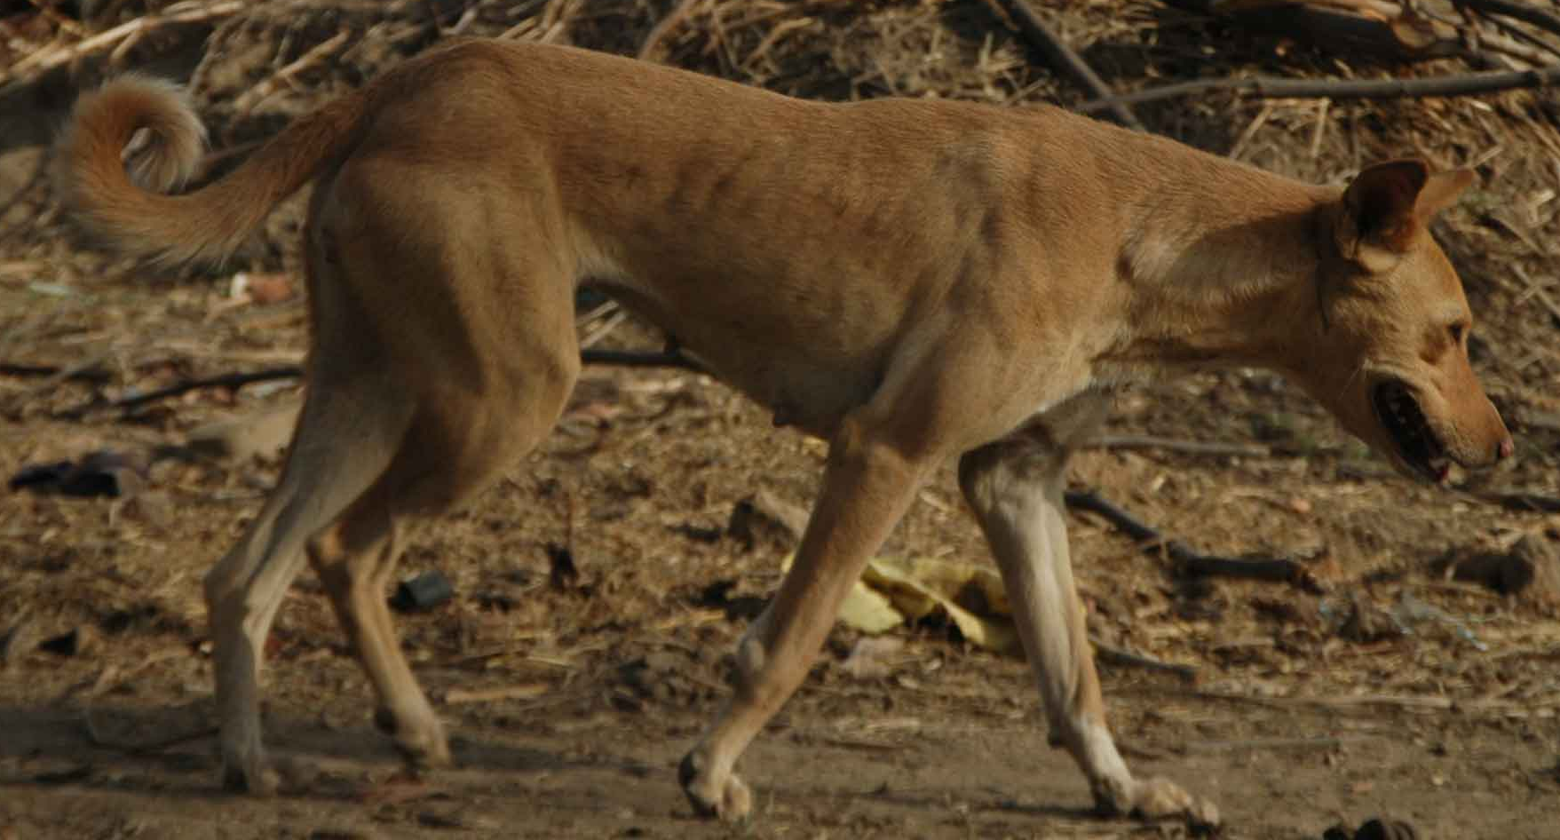


Brown Dog - A Science Driven Data Transformation Service
Extensibility
Easy to add new converters/extractors
Encapsulated software & dependencies
API
Support for diverse usage (i.e. Clients, Languages, Tools, and Scalability)
Provenance, Information Loss, Data Movement, Tool Preservation/Publication, and OPEN
https://en.wikipedia.org/wiki/Mongrel

Slide 27
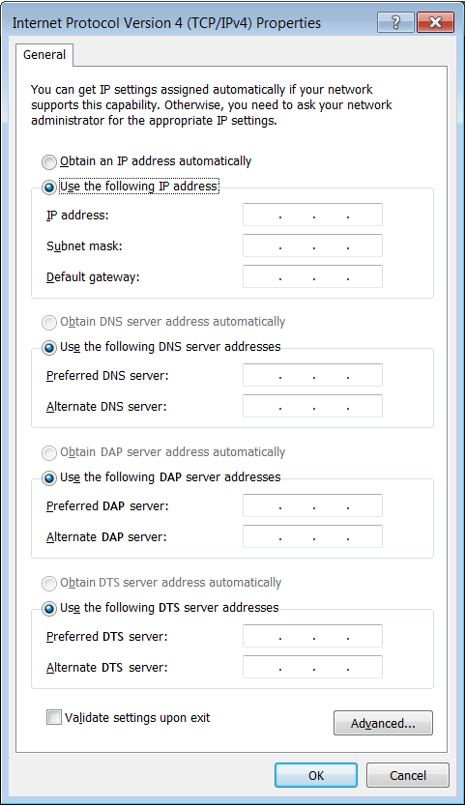
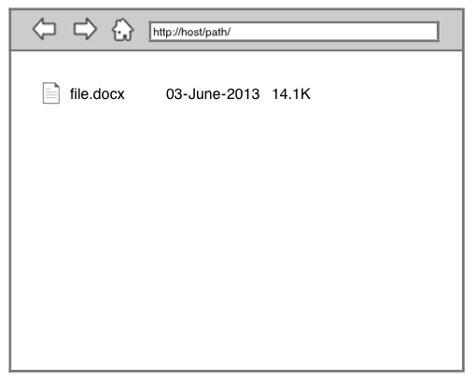
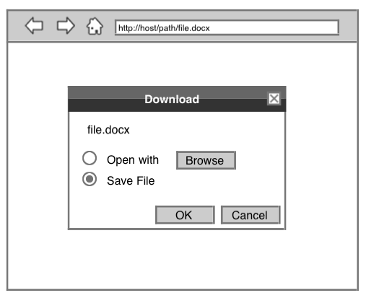
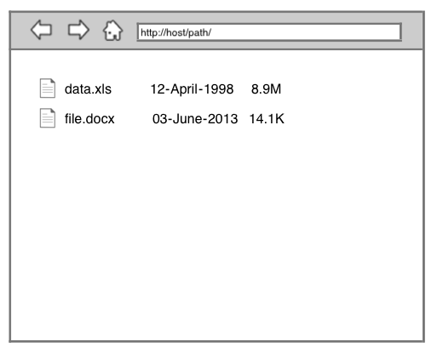
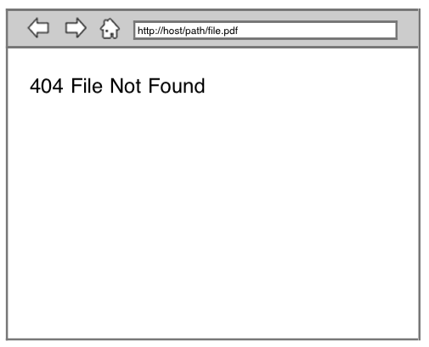
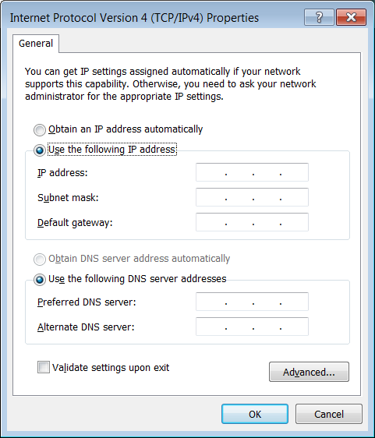
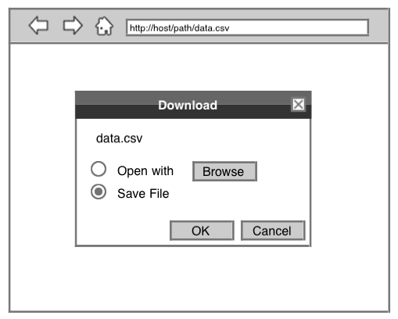
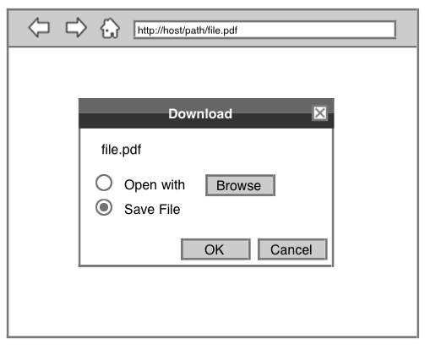
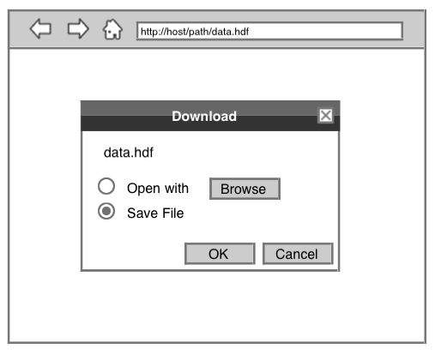
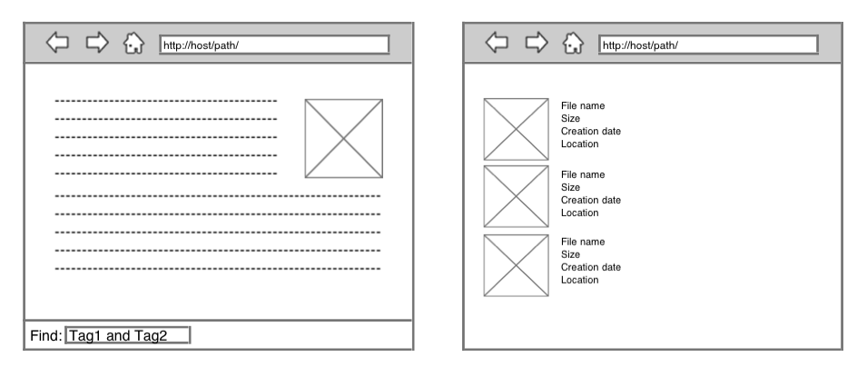
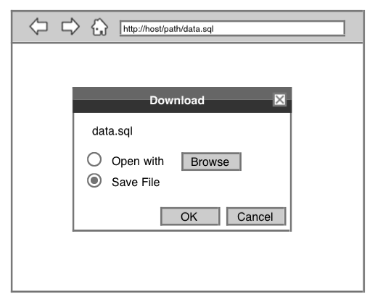
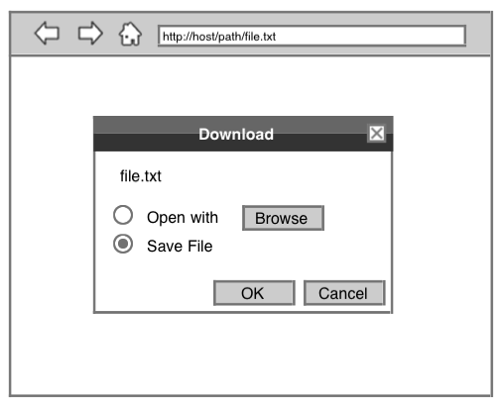
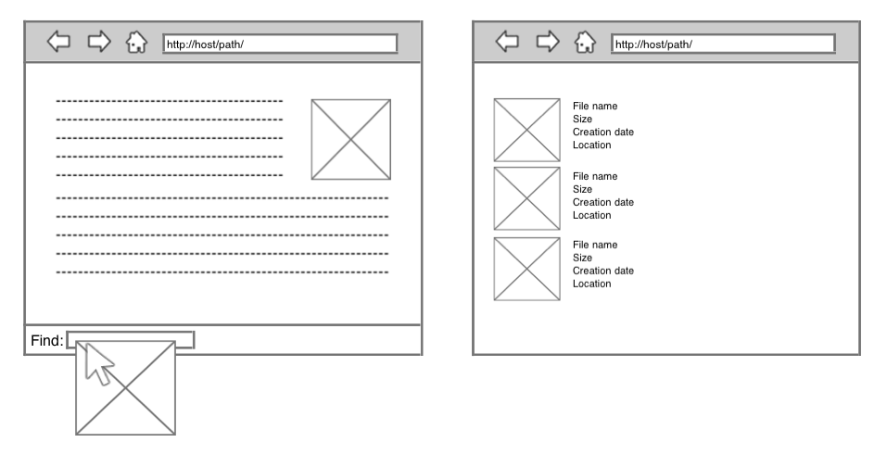
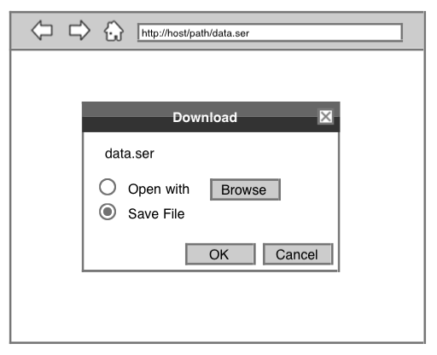

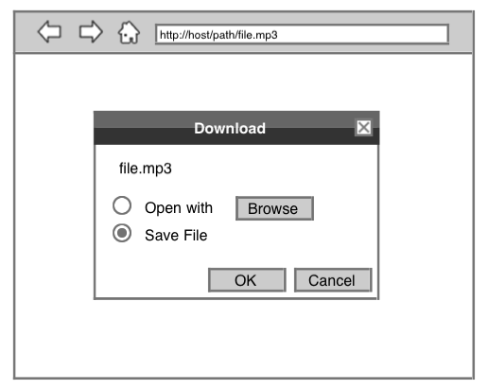
Data Access Proxy (DAP)
Distributed/Extensible data conversion service
File(s) in, File(s) out
Data transformations that largely preserve the entirety of the data (i.e. potentially reversible)
Aid in accessing a files contents independent of how it is represented on disk
Move towards an internet/world that is agnostic to file formats
Data Tilling Service (DTS)
Distributed/Extensible data extraction service
File(s) in, JSON-LD out
Data transformations that create new, often higher level, data from the contents of data (e.g. tags, signatures, and other derived products). Typically not reversible.
Provide means to query and/or relate unstructured/un-curated collections of data (i.e. data without metadata)

Slide 28
Brown Dog
... a Web Service
Programmable interface allowing client applications to build on top of them
Backed with computational and storage resources
Place to preserve/reuse software and tools dealing with data manipulation

Slide 29





















NSF DataNets DIBBs
Building a Scalable Infrastructure for Data-Driven Discovery and Innovation in Education
The Pacific Research Rim
Whole Tale
SPIDAL
Aristotle
Ken Koedinger
$4,830,819
2014-2019
MS-OSiRIS
Syndicate
Larry Smarr
$5,000,000
2015-2020
Bertram Ludaescher
$4,986,951
2016-2021
Geoffrey Fox
$5,000,000
2014-2019
Shawn McKee
$4,918,411
2015-2020
Larry Peterson
$3,804,911
2015-2019
David Lifka
$4,975,094
2015-2020
SciServer
The Data Exacell
GABBs
Kenton McHenry
$10,519,716
2013-2018
Alex Szalay
$7,603,723
2013-2018
Xiaohui Carol Song
$3,409,029
2013-2018
Michael Levine
$4,902,601
2013-2018
Margaret Hedstrom
$8,000,000
2011-2016
Reagan Moore
$8,300,992
2011-2016
Steven Ruggles
$7,993,266
2011-2016
Golam Choudhury
$10,085,120
2009-2014
Bill Michener
$21,194,548
2009-2014

Slide 30
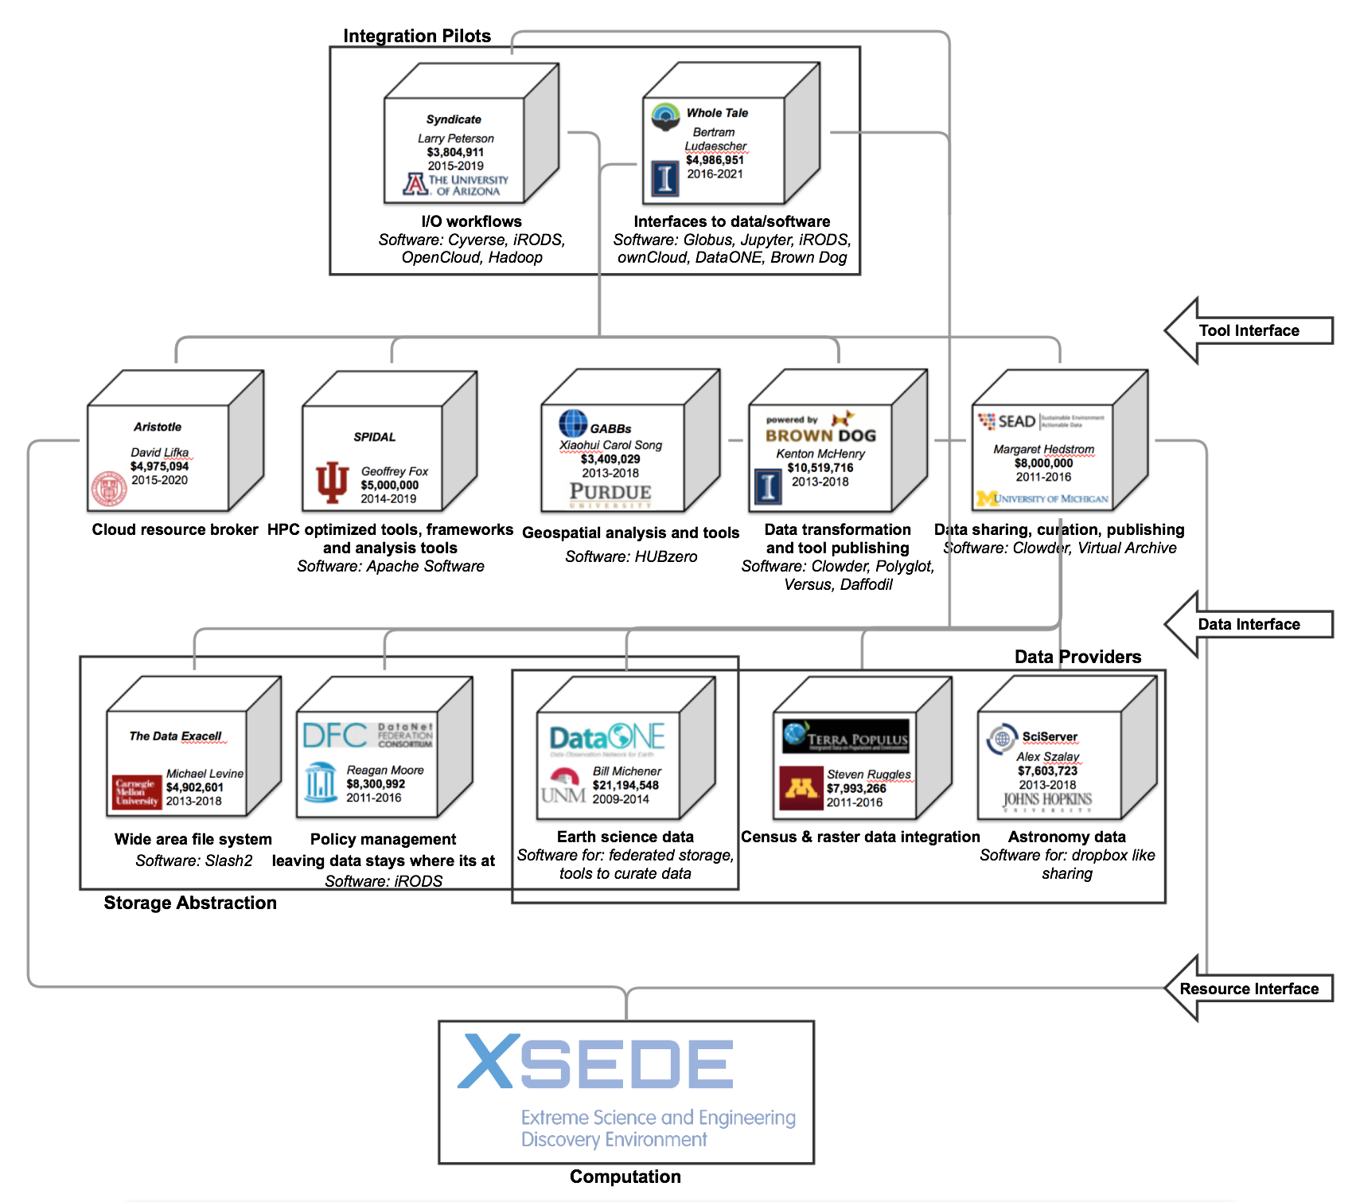
NSF DataNets DIBBs

Slide 31
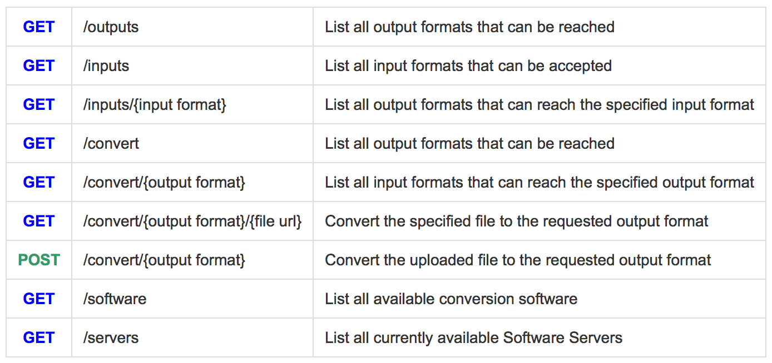
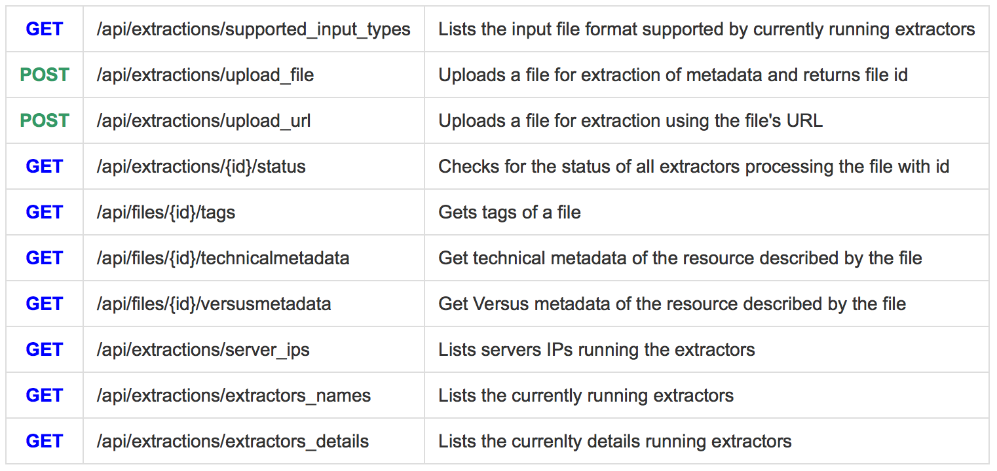

Slide 32
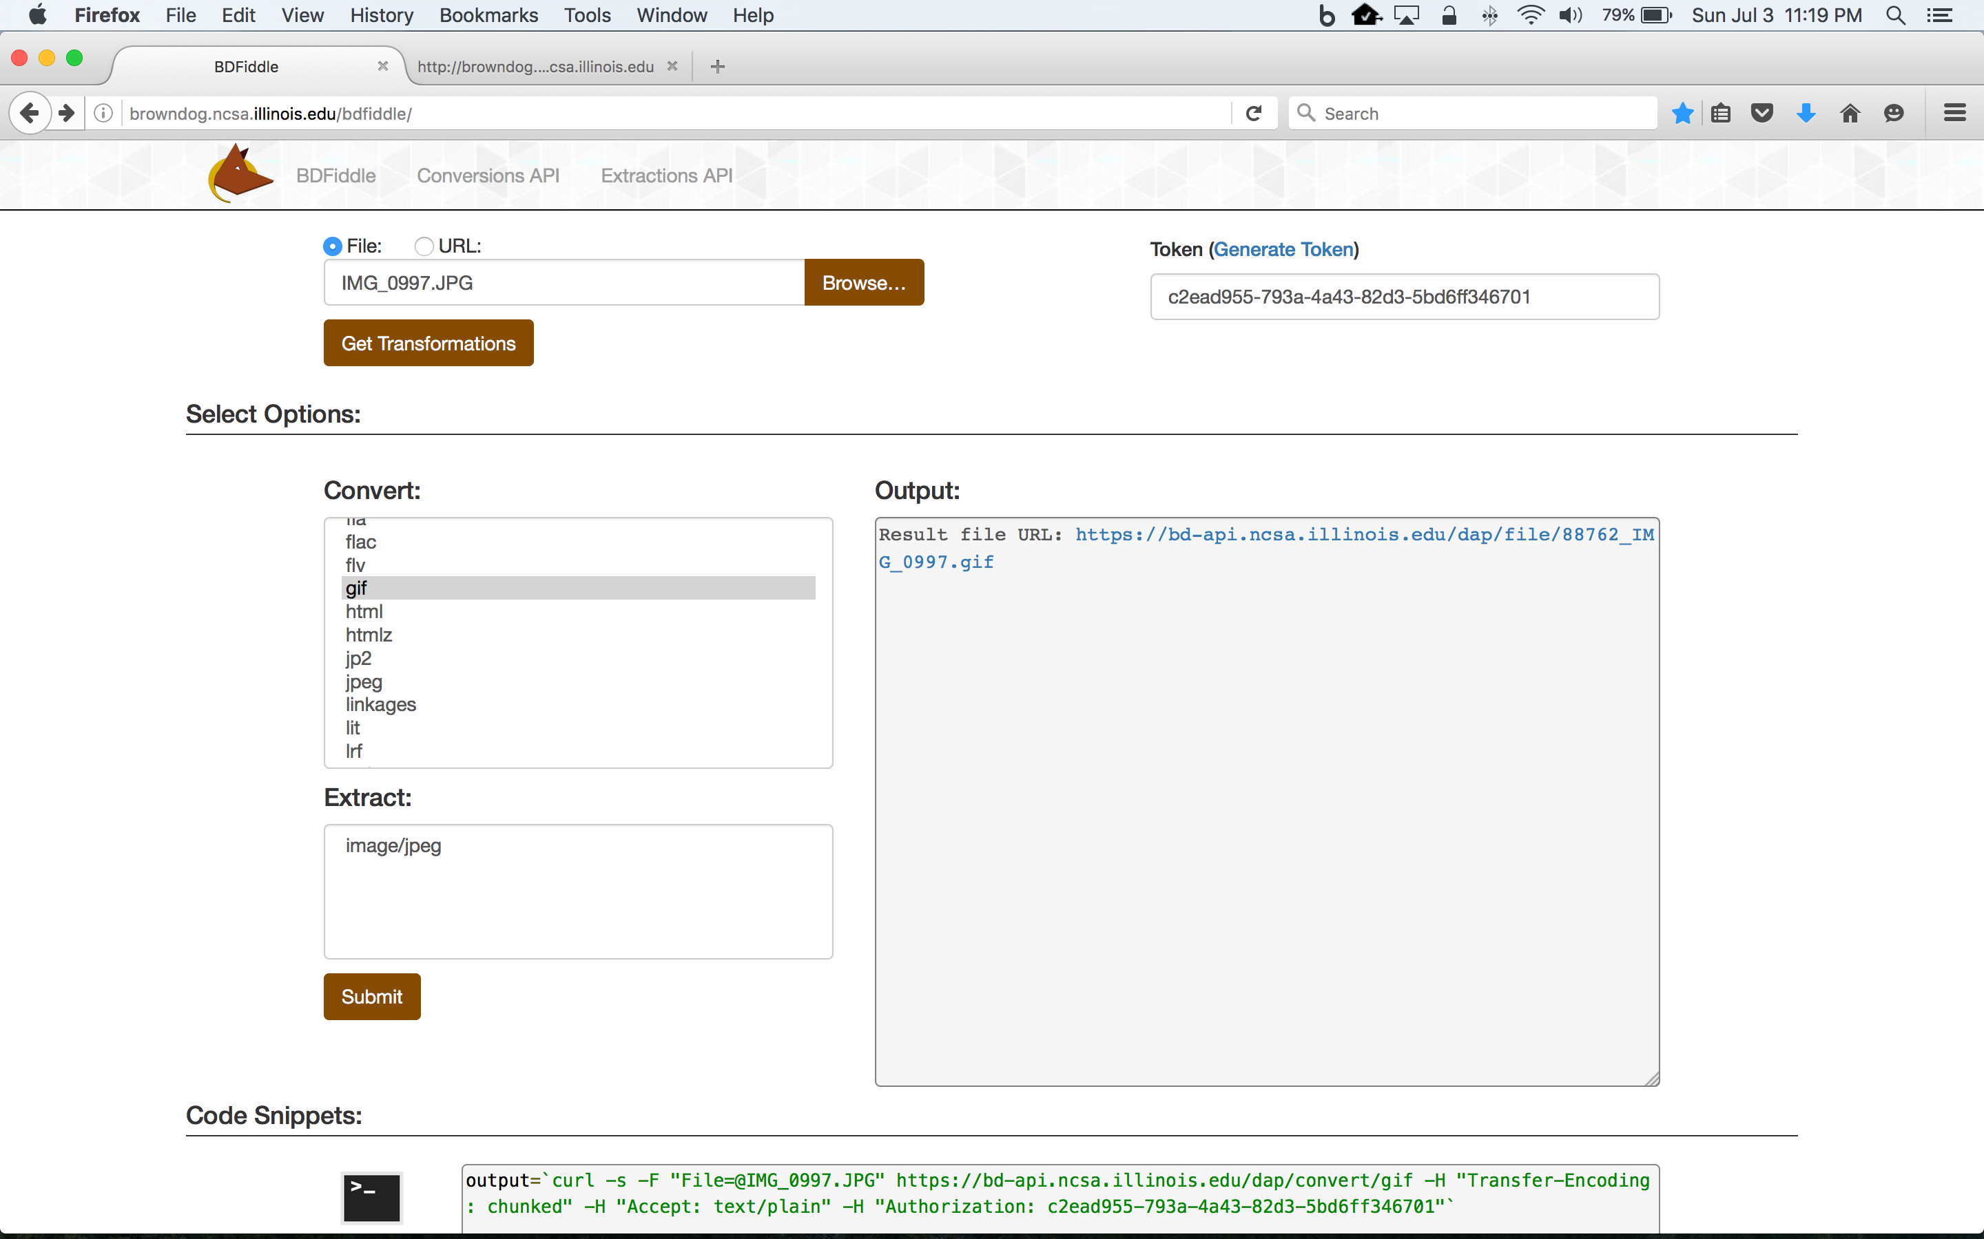
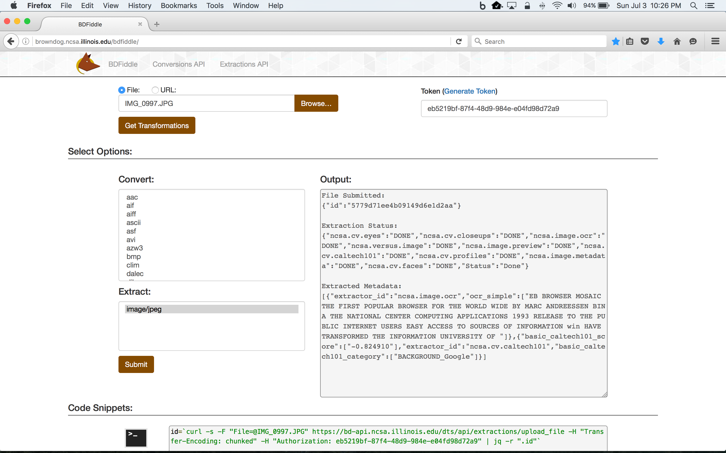
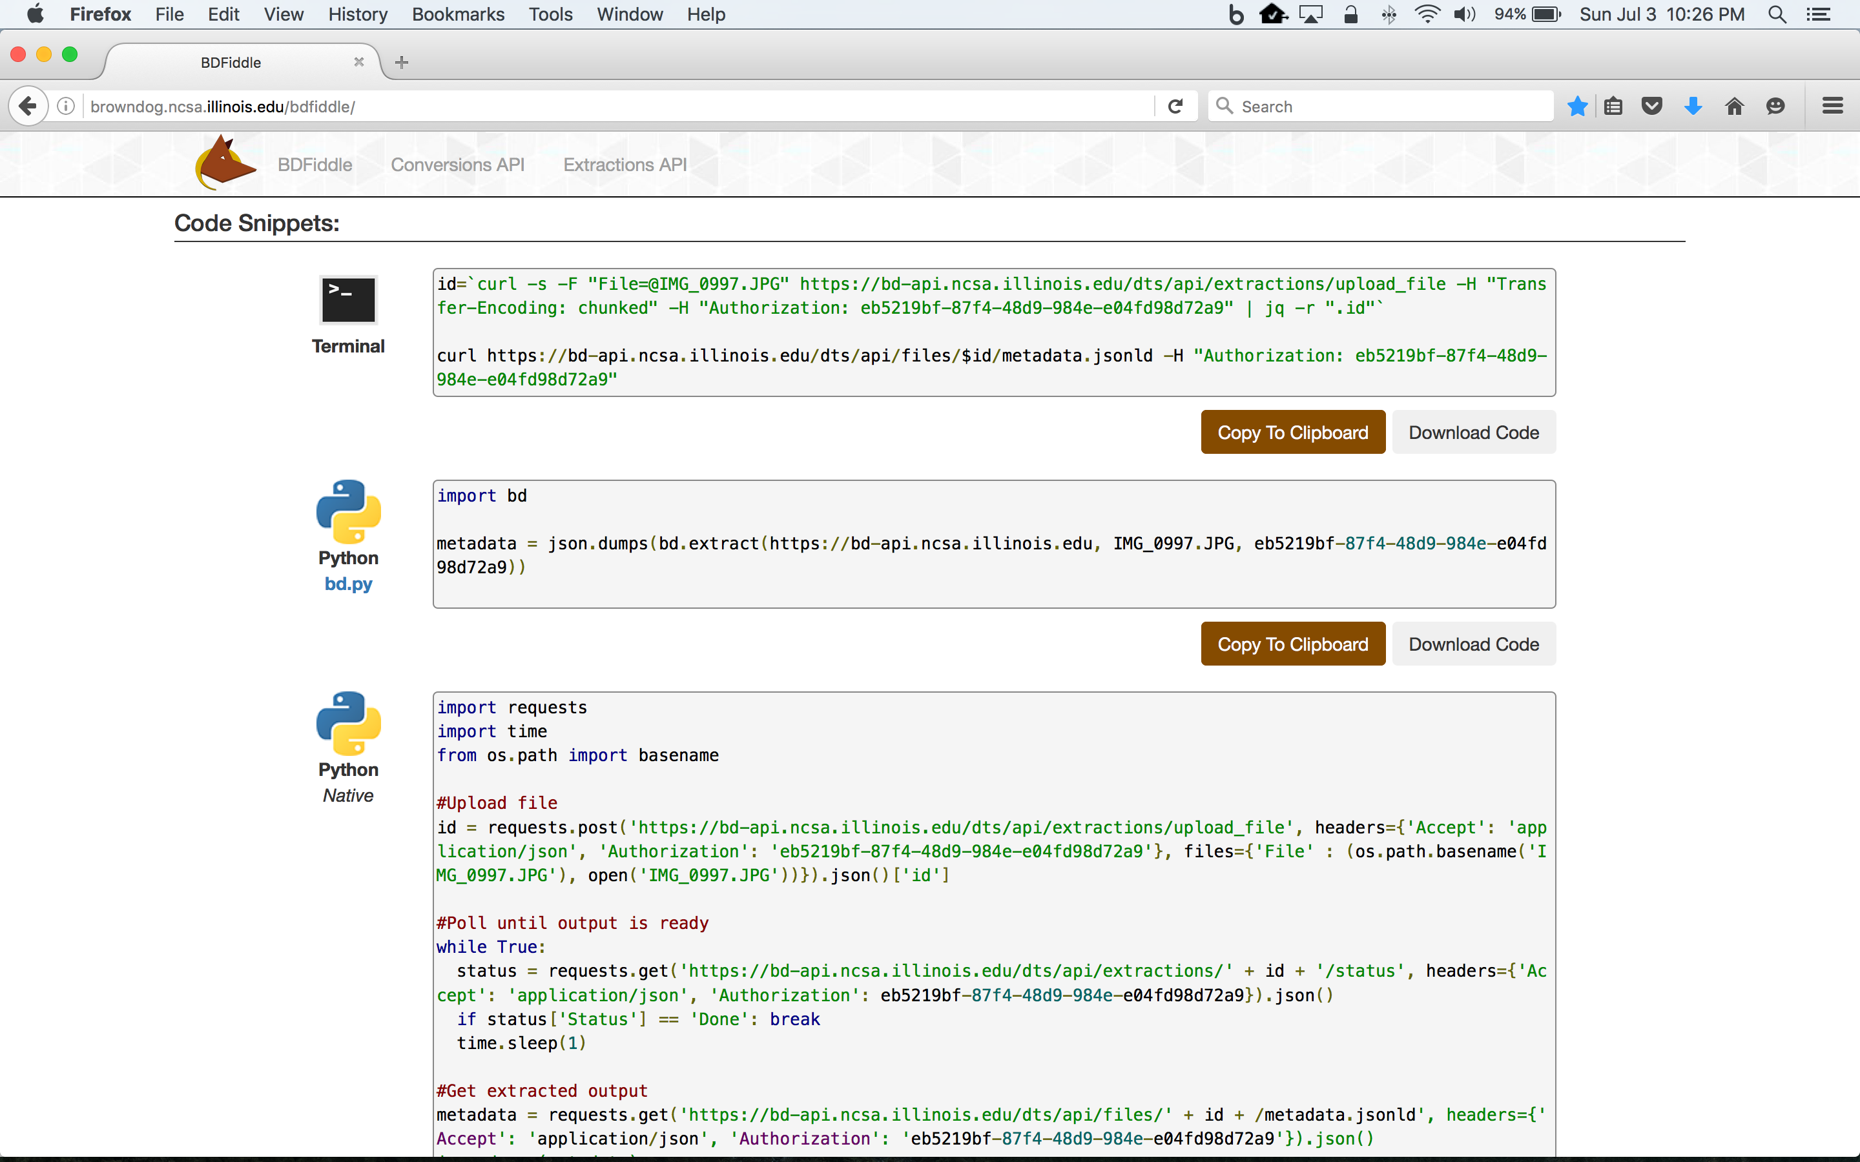

Slide 33


Slide 34


Slide 35

https://www.youtube.com/watch?v=MvaHQKT3BPQ

Slide 36





Slide 37


XSEDE: Large-Scale Video Analytics

Slide 38



XSEDE: Image Analysis of Rural Photography

Slide 39



XSEDE: Decomposing Bodies

Slide 40
Brown Dog Architecture
Web Browser (BDFiddle)
Clients
(e.g. bdcli)
HTTP/HTTPS
RabbitMQ (Event Bus)
HTTP/HTTPS
Fence (API Gateway)
NGINX (Load balancer)
NGINX (Load balancer)
Polyglot
…
Polyglot
Clowder
Clowder
…
MongoDB
MongoDB (Data, Metadata)
Converter (Software Server)
Converter (Software Server)
Extractor
Extractor
…
…
Conversions
Extractions
Notes:
We show here the architecture of the Brown Dog services: i) The DTS is built on top of the Clowder framework which is a web-based content management system. Using the DTS REST API, a user can upload a file/dataset or url to a file to the DTS. This triggers specific extractors based on appropriate MIME types, for extraction of metadata, signatures or any derived product from the file’s content. Inside DTS, there is a distributed messaging bus, RabbitMQ, which reliably distribute and manage job execution by placing messages in a queue for each extractor, and removing them when job done. Extractors listens to the RabbitMQ for new messages for extraction. It saves all input files, dataset and outputs in MongoDB. Extractors can be written in any language as longs as it can communicate with RabbitMQ and Clowder REST interface via HTTP – Java, Python, Scala, C/C++. Extractors are deployed within distributed cloud environment.
Data Access Proxy, It is built on top of the Polyglot framework and provides REST API allowing users and applications to use its conversion capabilities. One of the key component is Software Server which hosts one or more applications. It uses light weight wrapper script to automate specific functionalities within the application and then provide access to it via a consistent REST API. Software Server listens a RabbitMQ bus for any conversion jobs and has a queue for each software it controls. DAP polyglot head node monitors the RabbitMQ bus and queries for all available Software Servers and the software’s input and output formats it supports. It constructs a Input/Output graph, finds the shortest conversion path between specific input and output format and allow SS to do the conversion.

